Slide 1
Excel final assessment
4287- Kollimarla Lakshmi kamakshi

Slide 2
Task-2
Insights: The average time gap for a video to become trending is about 1 day

Slide 3
Task 3
Insights: education and pet animals categories has highest engagement rate

Slide 4
Task 6
Insights:It is observed that the interaction on videos with comments enables is more

Slide 5
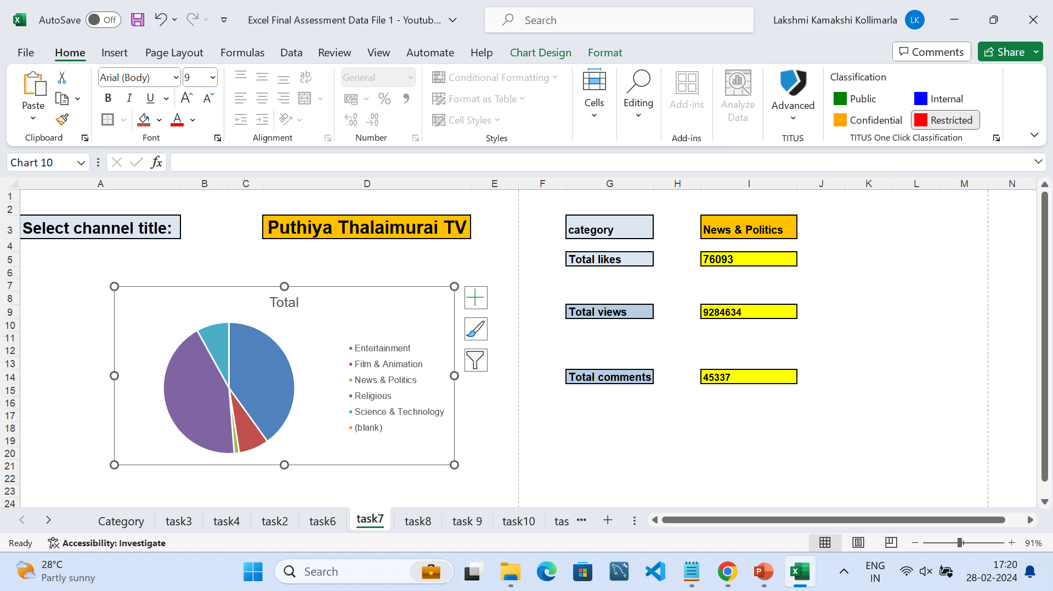
Task 7

Slide 6
Task 8
Insights: the videos with top 5 engagement rates are:
Q3jege0p0dQ
6Q0AazVu1Tc
45Nkhoa72gY
XYviM5xevC8
rucOLpxX6WE

Slide 7
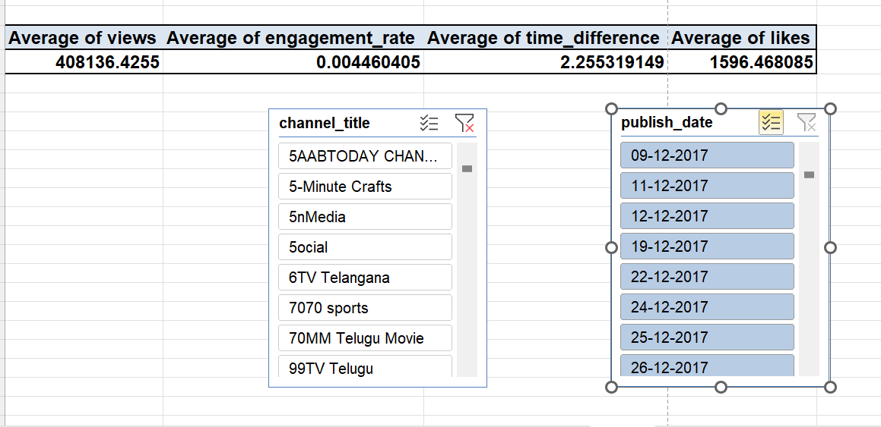
Task 9
Insights:

Slide 8
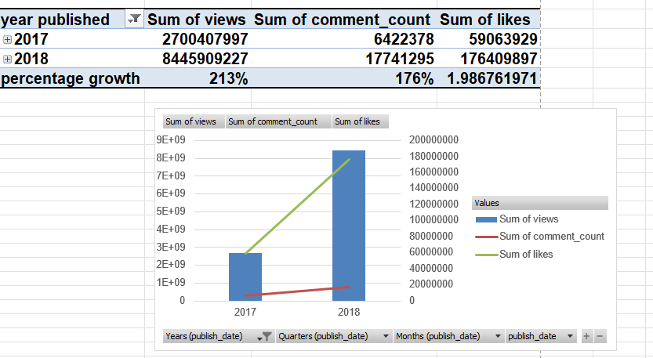
Task 10
Insights:

Slide 9
Task 11
Insights: through the coherent analysis it is found that the t series channel has a increase in retention from 2017-2018

Slide 10
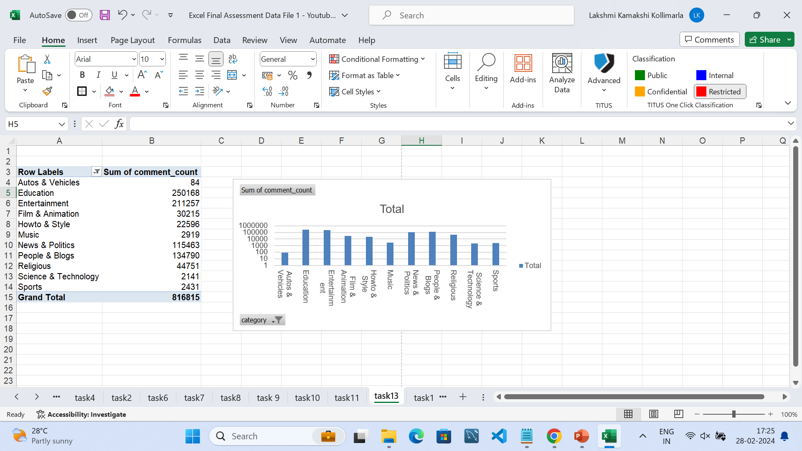
Task 13
Insights:

Slide 11
Task 14
Insights:

Slide 12
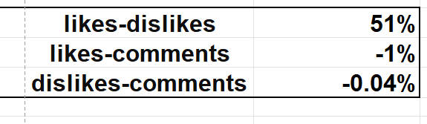
Task 15
Insights: likes and dislikes have positive correlation, where as likes, comments and dislikes –comments have negative correlation

Slide 13
dashboard
Insights:

Slide 14
Task 13
Insights:

Slide 15
Task 14
Insights:

Slide 16
Task 15
Insights:

Slide 17
Task 16
Insights:

Slide 18
Task 17
Insights:

Slide 19
Task 18
Insights:

Slide 20
Task 19
Insights:

Slide 21
Task 20
Insights:

